Slide 1
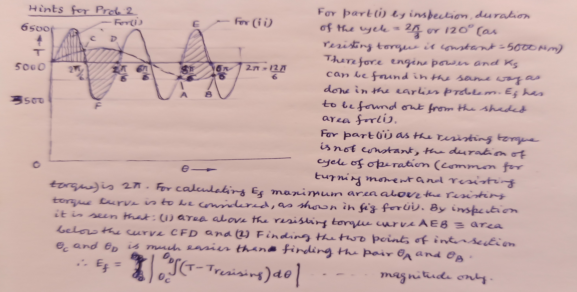
Hints for Prob. 2 – Type 1 (ii)

Slide 2
Problems - Type 1 (iii)
In a turning moment diagram of an engine, areas above and below the mean torque line (located 1 cm above the θ-axis) taken in order are -0.32, +4.08, -2.67, +3.33, -3.1, +2.26, - 3.74, +2.74 and -2.58 cm² respectively. The scales for T and θ are 1 cm = 6 kNm and 1 cm = 14⁰ respectively. The mean speed is 200 rpm with total fluctuation of 3%. Assuming the radius of gyration of the flywheel as 106 cm find out mass of the flywheel and the power of the engine. Find and indicate the points on the TM diagram where the maximum and minimum speeds will occur.
(**Note: instead of stating the areas by + or – sign in the problem, they can be stated by areas above and below the mean torque line)
An additional problem of Type 1 (i)
The turning moment diagram of a four stroke engine is assumed to be represented by four triangles, the areas of which from the zero pressure line are: Suction stroke -440 mm², compression stroke -1600 mm², power stroke +7200 mm² and exhaust stroke -660 mm². Each mm² of area represents 3 Joules of energy. If the resisting torque is uniform, determine the mass of a flywheel to maintain the speed between 218 and 222 rpm when the radius of gyration of the flywheel is to be 1.25 m.

Slide 3
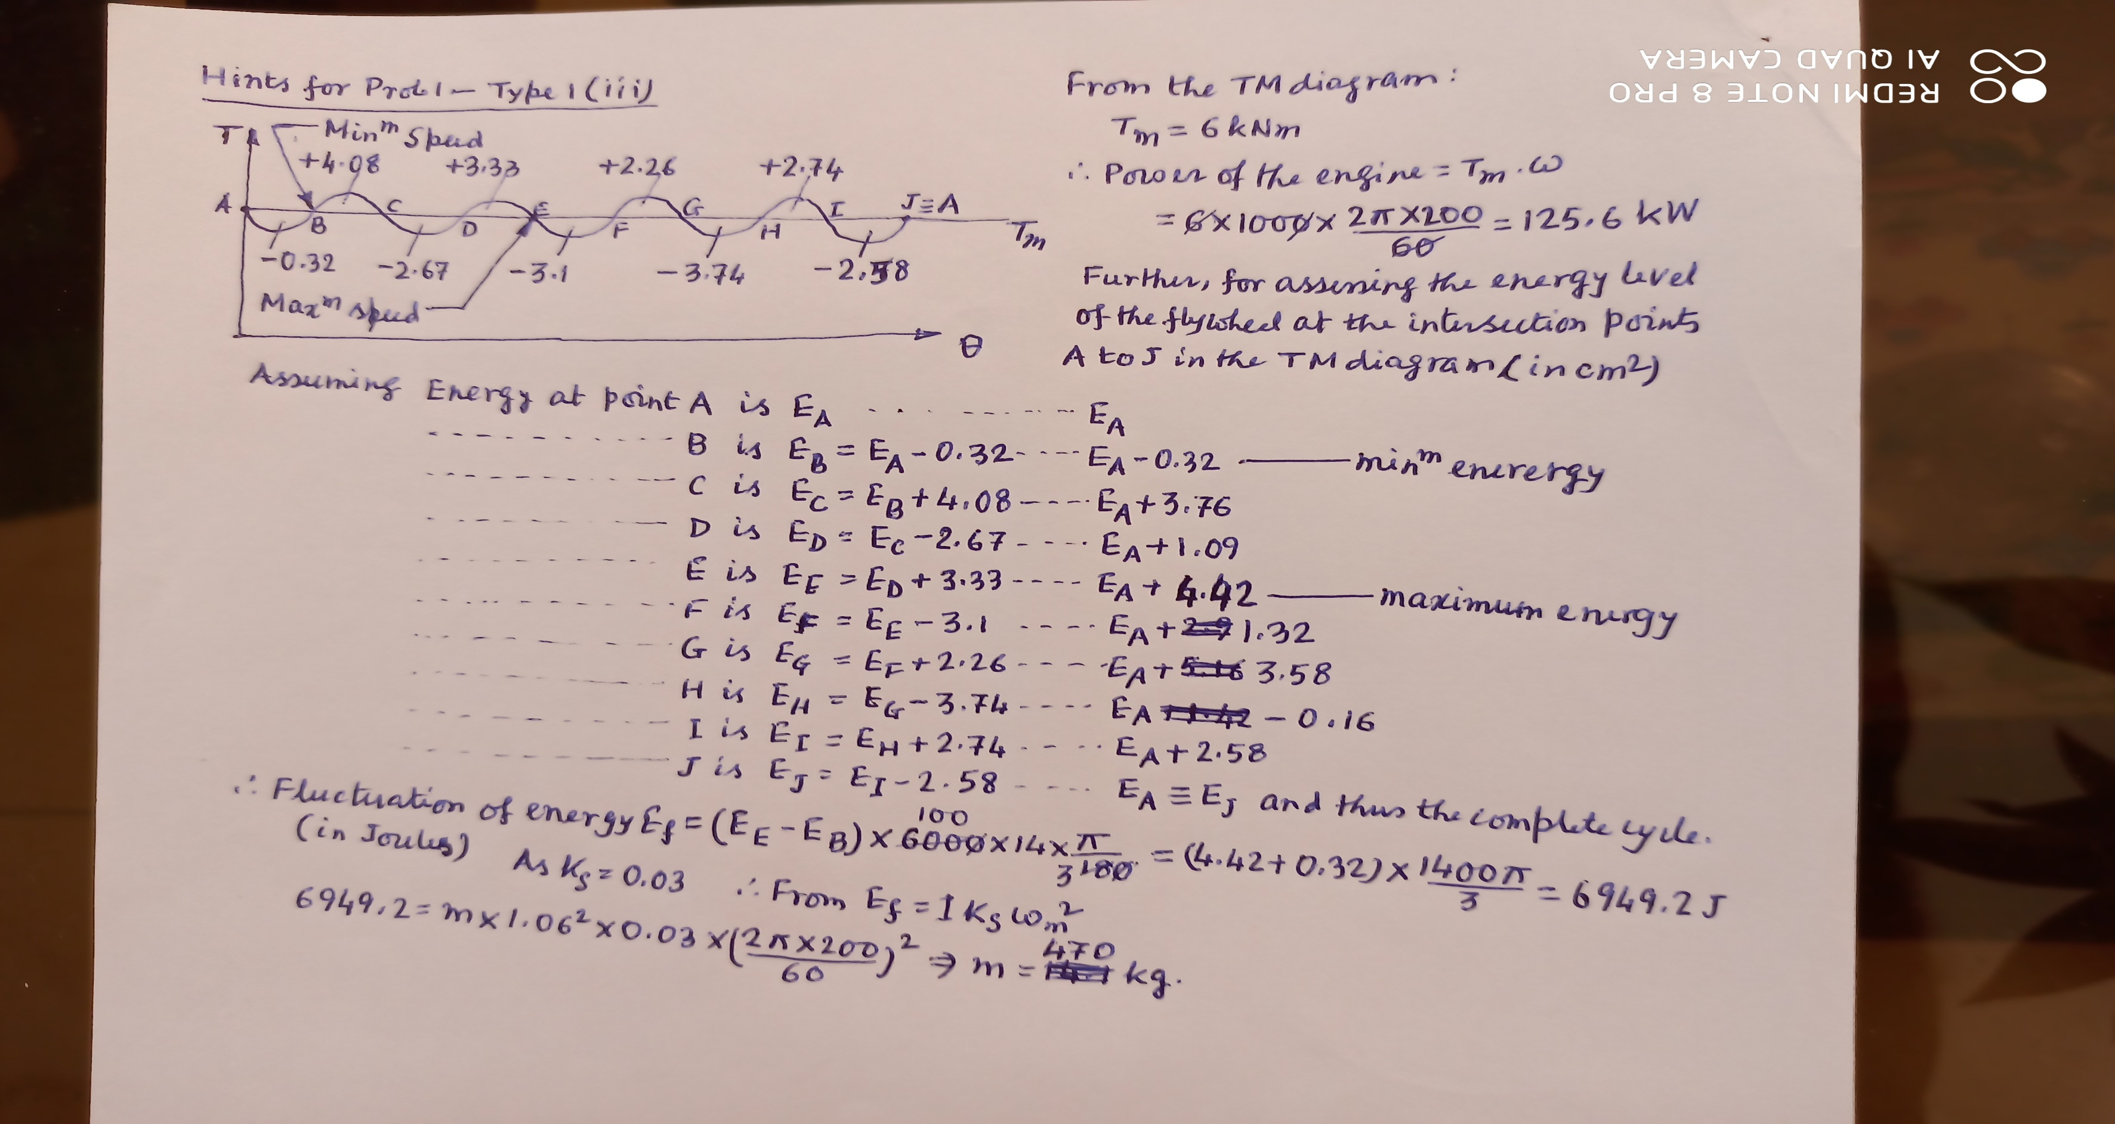
Hints for Prob. 1 – Type 1 (iii)

